Slide 1
EC48W Exploratory Data Analysis
Çağatay Doruk Balcı, Fatih Yavuz, Fevzi Cem İz, Ece Taşan, Mert Bakcacı

Slide 2
Datasets
Economic Freedom Dataset(Measures the degree to which the policies and institutions of countries are supportive of economic freedom,2015-2018)
Happiness Index(2015,2016,2017)
Suicide Rates Overview(Socio-Economic info and suicide rates on country basis,from 1986-2016)
We took 2015 as the year of interest to use all the datasets.

Slide 3
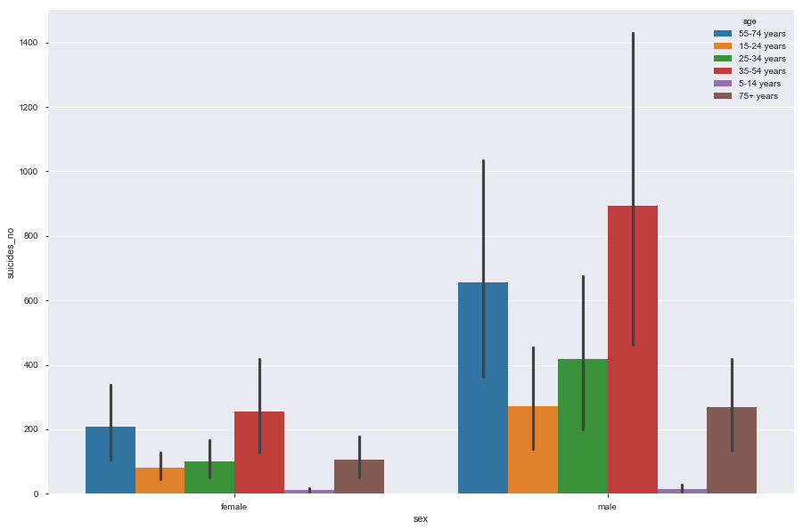
Number of Suicides with respect to gender and age

Slide 4
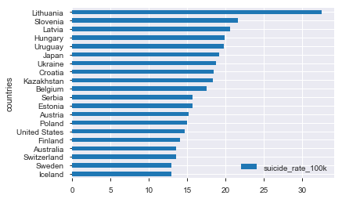
20 Countries with Highest Suicide Rates

Slide 5
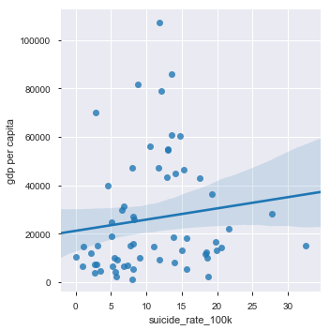
Relationship between GDP per Capita and Suicide Rate

Slide 6
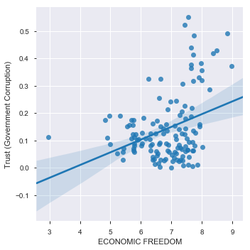
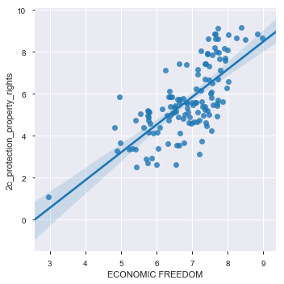
Economic Freedom

Slide 7
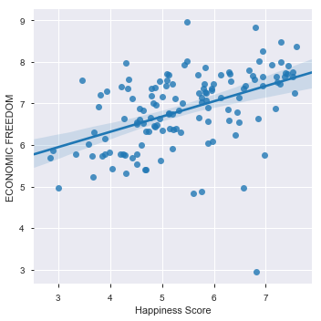
Relationship Between Economic Freedom and Happiness Score

Slide 8
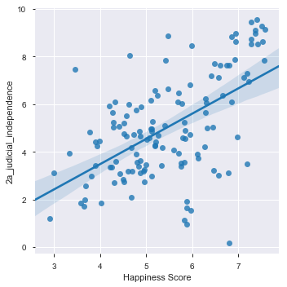
Happiness Score and Judicial Independence

Slide 9
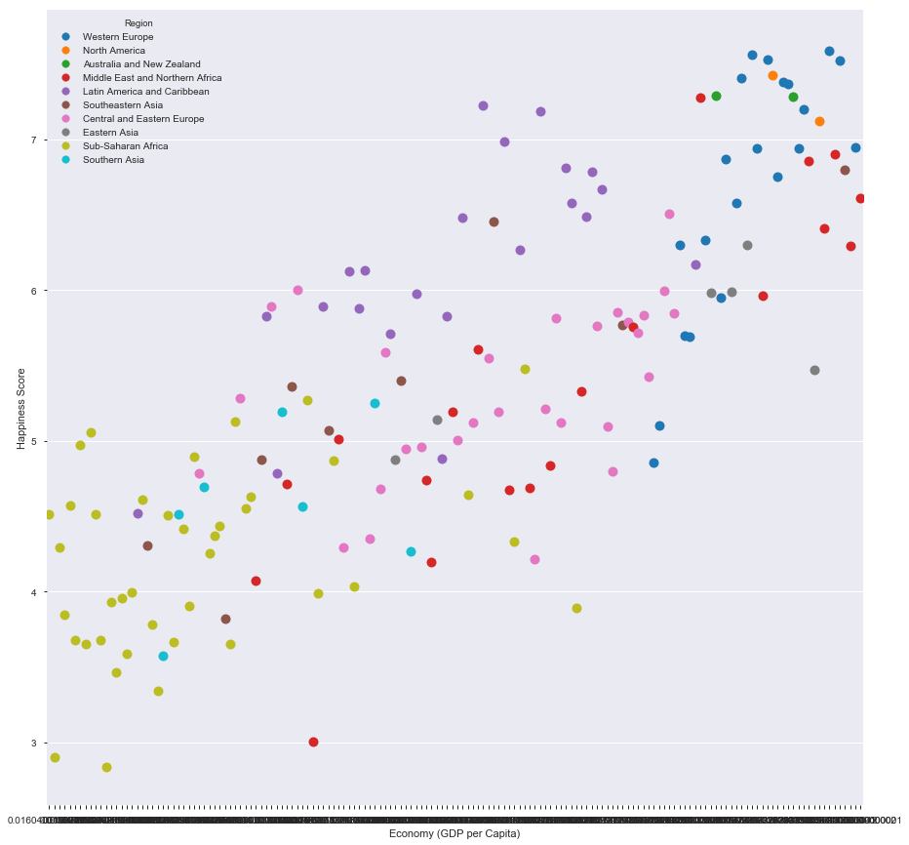
GDP per Capita & Happiness Score

Slide 10
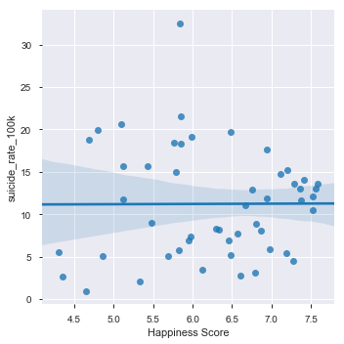
Relationship between Happiness Score and Suicide Rates

